Slide 1
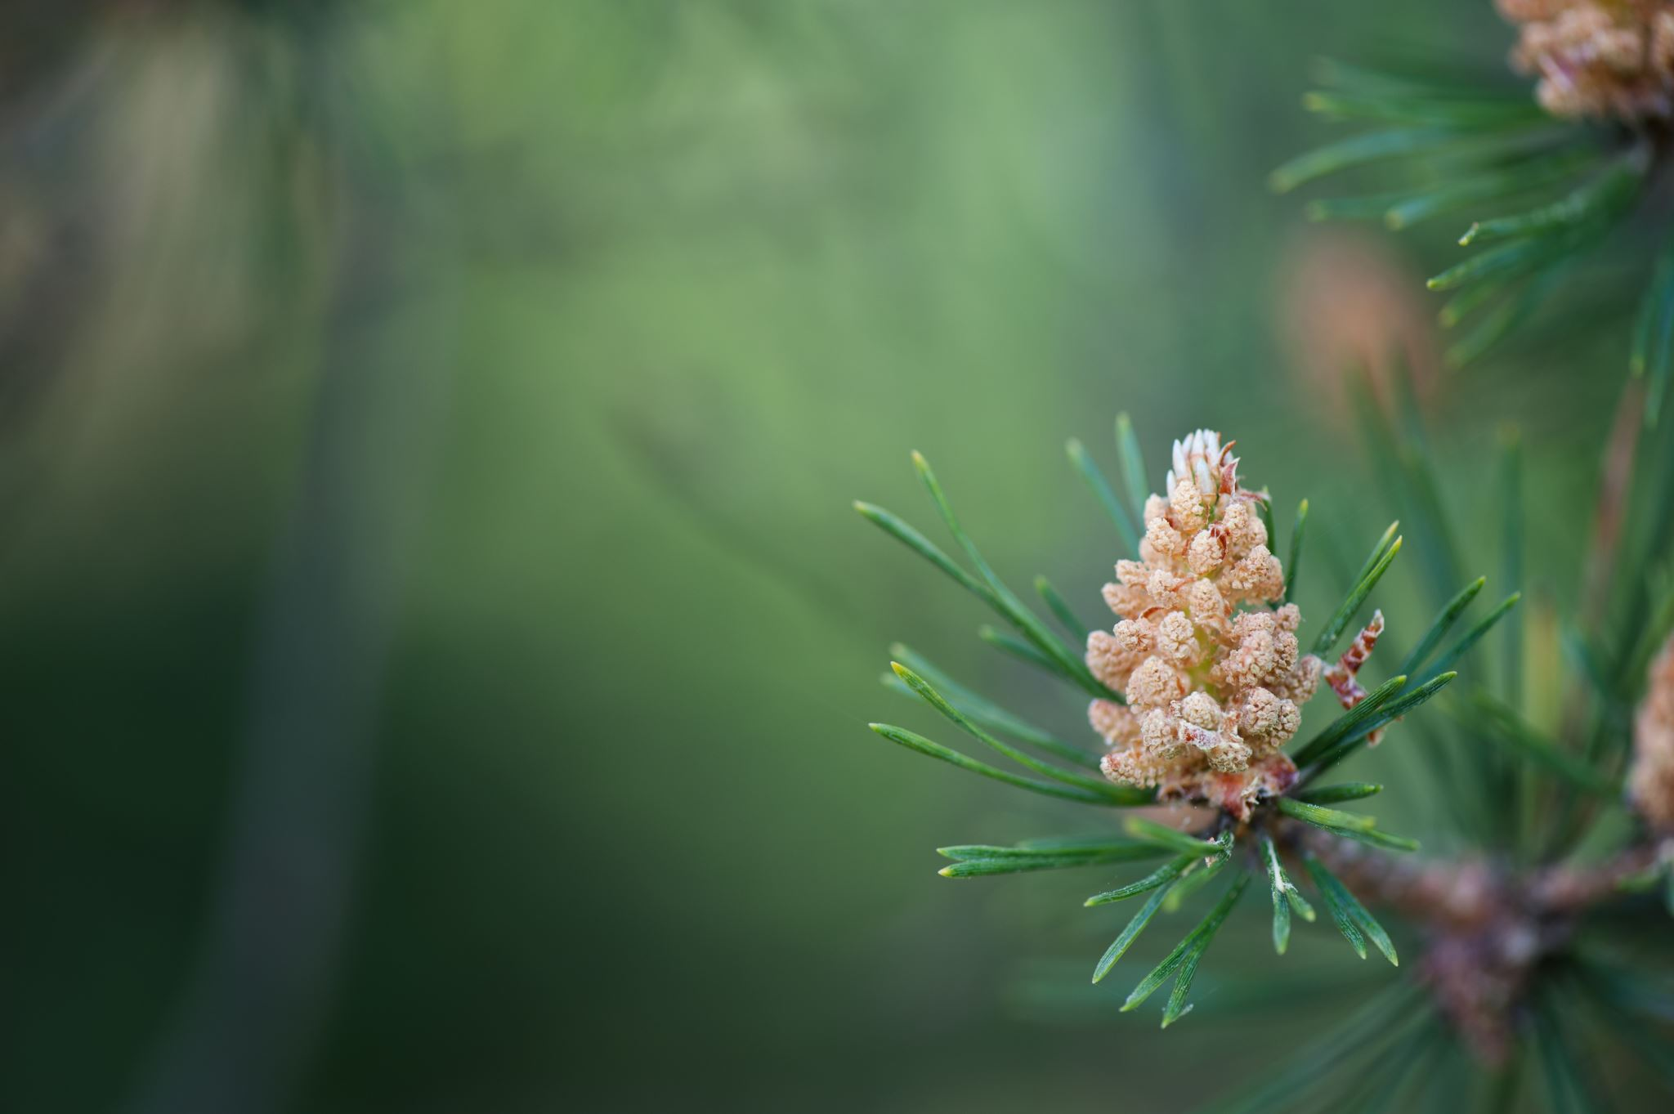
PPM 080424 Oak Cynipidae Pine Brown Spot Needle Blight

Slide 2
Brown spot needle blight
Scotch and Ponderosa
White pine not as common.
Reddish brown spots on needles.
Needles can stay green where they attach to the shoot. Needles often fall end of season
Frequently confused with dothistroma (common on Austrian, red pine, Mugho)
Sprayed 3 times in the spring like dothistroma.
Environmental protections are limited to sanitation (raking up needles) and redirecting sprinklers away from needles to make conditions less favorable to fungal growth.

Slide 3
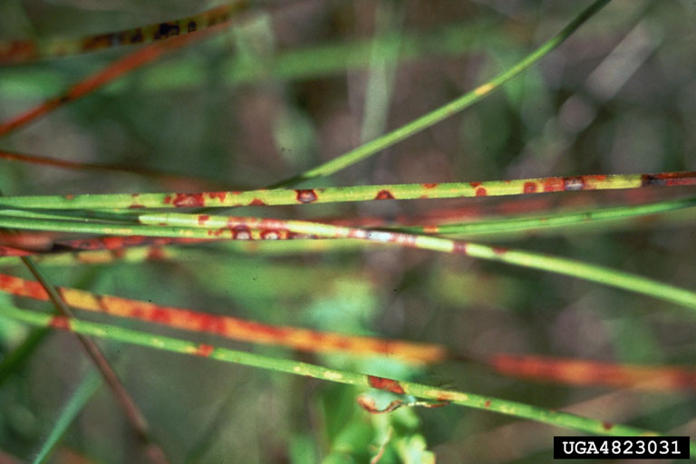
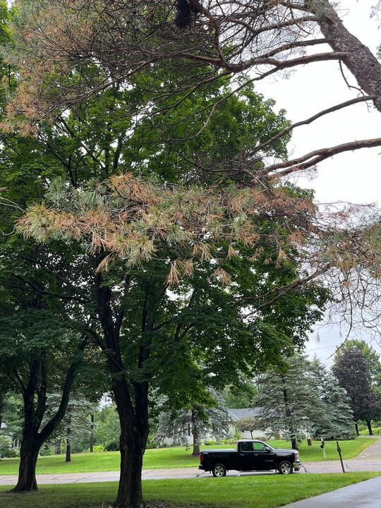

Slide 4
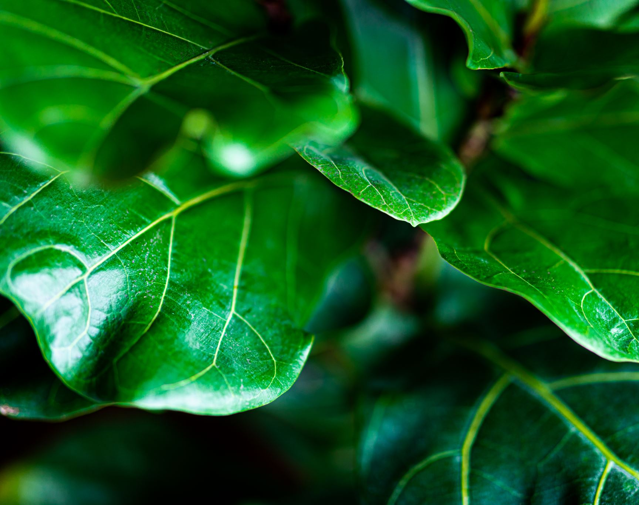
Jumping oak gall Neuroterus saltatorius
Caused by cynipidae: small stingless wasps
Non lethal
Cosmetic only, looks like confetti on the leaf
Called jumping because the wasp larva is moving around inside the gall. They often fall off the leaf when they near maturity.
Found on white and bur oak.

Slide 5
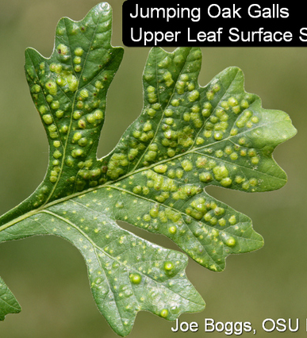
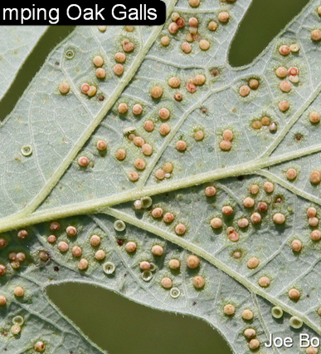

Slide 6
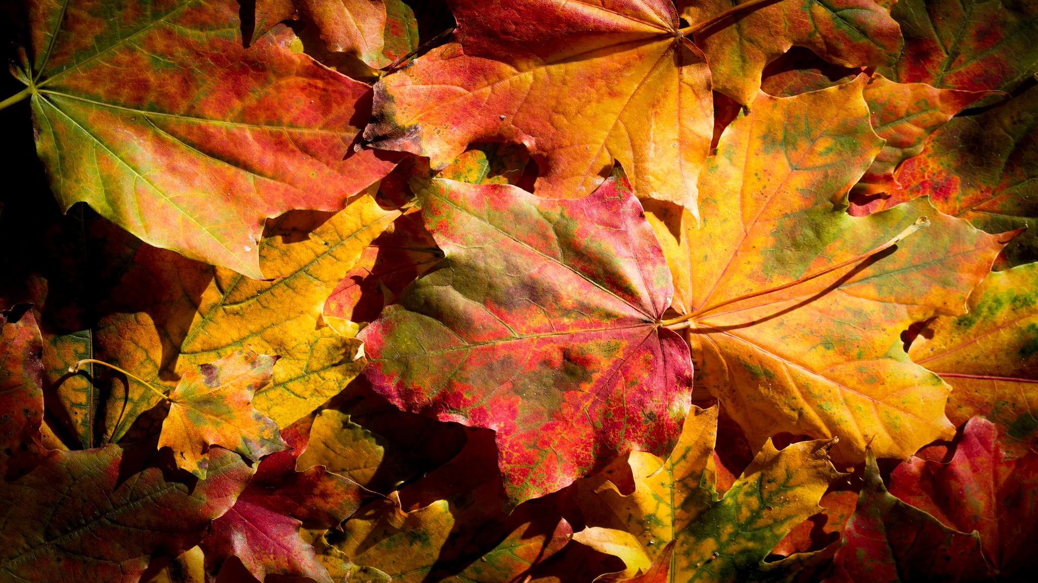
Oak bullet gall Disholcaspis quercusmamma
Caused also by cynipid wasps
Adult lays egg on leaf or twig, tree grows shell around it
Wasp bores its way out when ready to fly off.
Trees this time of year will begin to host thousands of tiny yellow wasps that are not interested in what we’re up to. I believe they are harmless.
Galls do not disrupt vascular functions inside twig.
Found on bur oak and less commonly on Bicolor Oak (swamp white)
Oak bullet gall can attract other species of wasps and hornets that feed on the nectar these galls produce but they are not being produced by the galls. So you may see yellow jackets for instance on the galls but they are not nests by any means. The other wasp and hornet species are simply feeding on the nectar produced on the exterior of the gall.
No treatment is necessary for this. If it’s a problem for some home owners it could be treated with a systemic insecticide for the following year.
Older galls will not fall off after treatment as they are part of the twig but will eventually shed.

Slide 7
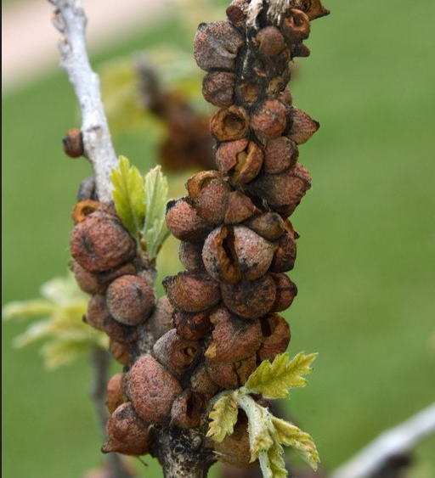
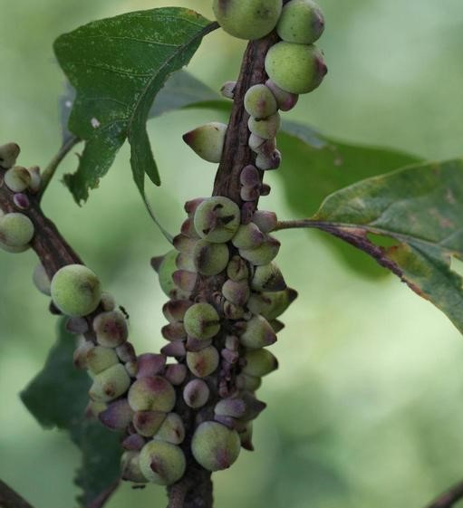

Slide 8
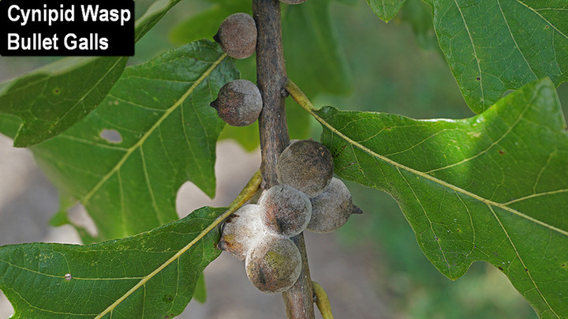

Slide 9
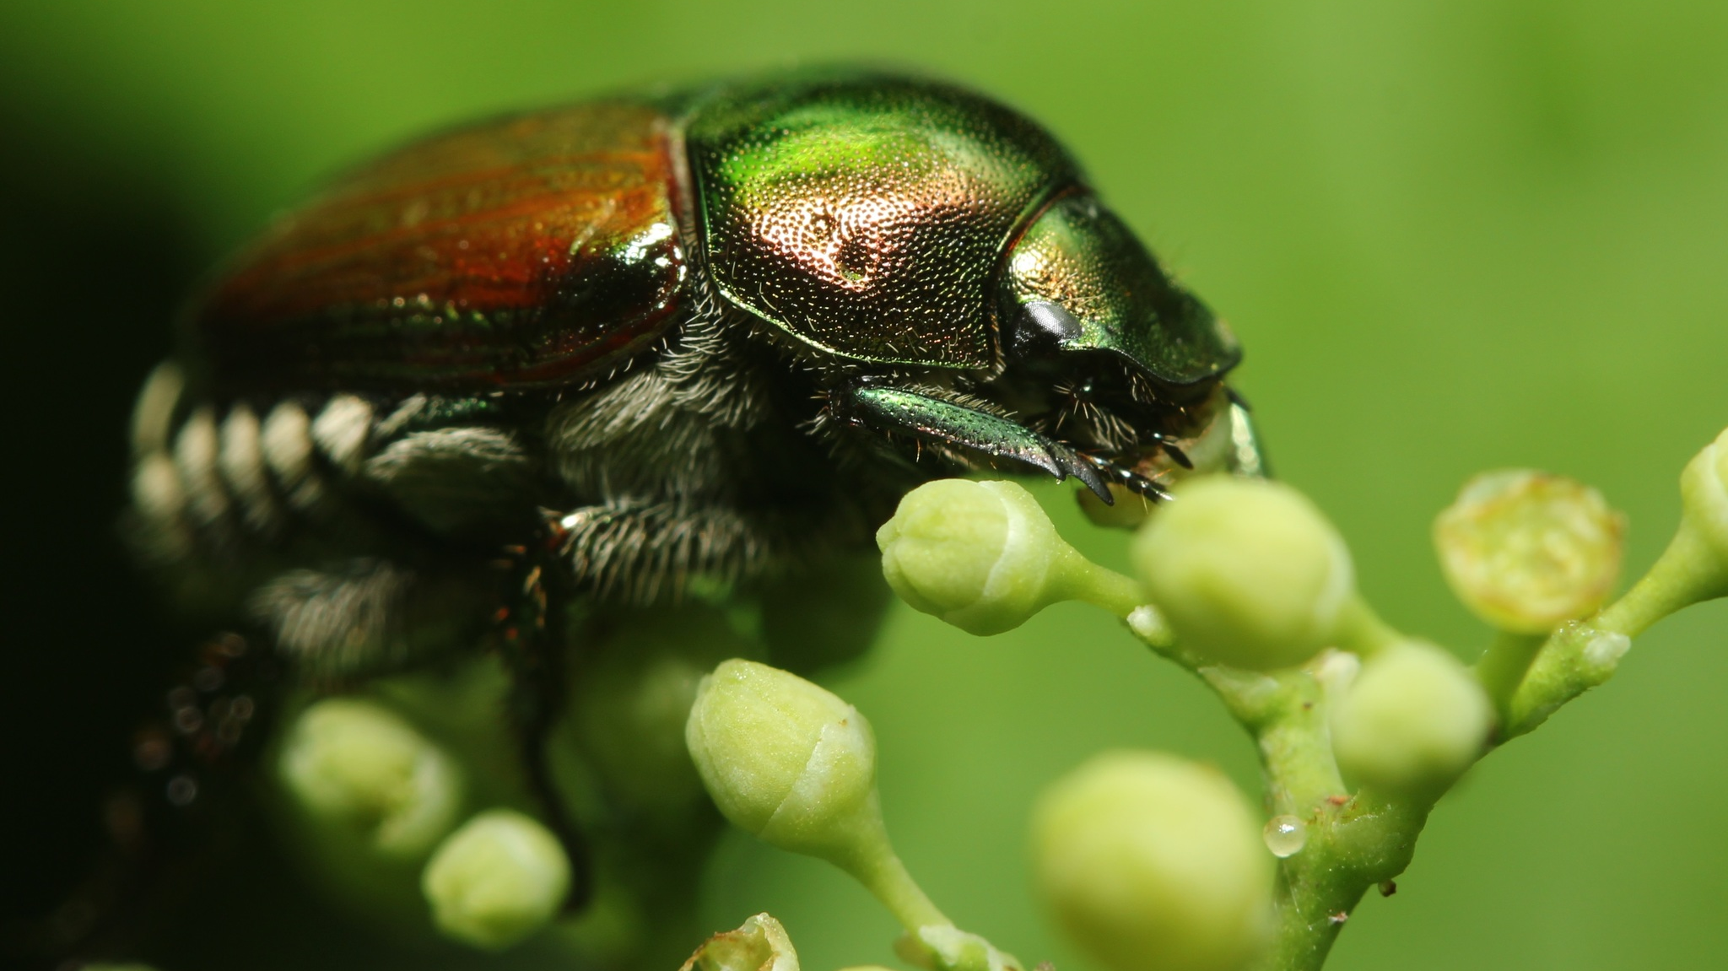
Japanese beetle
Feeds on 300+ plant species
Does not kill trees by itself.
Perpetual early defoliation can reduce plant vigor.
Adults feed on foliage and skeletalize leaves.
Larvae overwinter in the soil and feed on turf root systems in the spring.
Treatment options include foliar sprays of permethrin during adult feeding seasons as well as soil injected imidacloprid to control grubs.
Currently and over the next 6 weeks extremely obvious especially in elm birch linden and most rosaceae (apple, crab, cherry, plum) but many tree species are susceptible. Seen frequently on raspberry bushes and vines as well.
This Photo by Unknown Author is licensed under CC BY

Slide 10
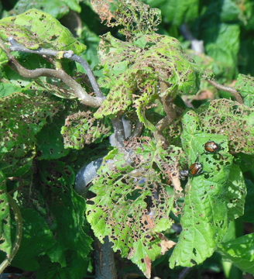
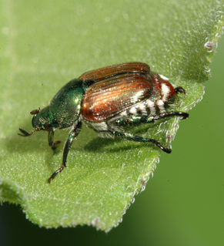

Slide 11
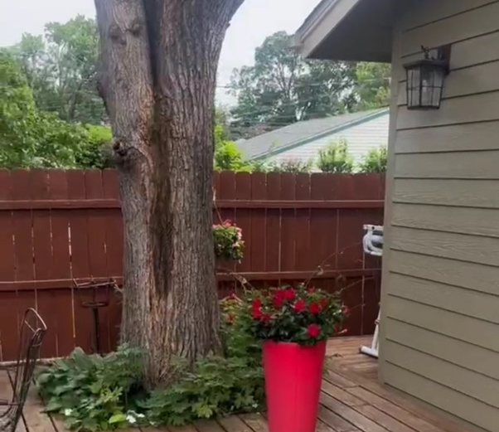
Random PPM subjects worth mention: How do we treat or fertilize trees beneath structures like a deck?

Slide 12
Fertilizing/Injecting under structure
Trunk injections: MN Jet
Soil drench alternative for macros
Runoff important to control
DED: Inject higher? This approach is better than not at all
Soil probe not necessary to provide fertility in absence of competitive vegetation.
Spring/Summer/Fall as well as Root Developer labelled for soil drench
Potential draw backs: Soil drench in someone’s front yard may disfigure or burn turf.
Fantastic alternative if irrigation system is in lawn or locations unknown. Wait for chemical to soak into turf and water in to penetrate root system.

